Slide 1


ENABLING RESILIENT EMERGENCY COMMUNICATION:
MANET-BASED SYSTEM FOR NATURAL DISASTERS
GROUP 10
Department of Computer Science and Engineering, Amrita Vishwa Vidyapeetham(Amrita University), Amritapuri Campus, Kollam

Slide 2
Our Team
ANUVIND M P (AM.EN.U4AIE22010)
HARISHANKAR BINU NAIR (AM.EN.U4AIE22023)
R S HARISH KUMAR (AM.EN.U4AIE22042)

Slide 3
- Roles & Responsibilities
- Introduction
- Problem Definition
- Literature Review
- Implementation
- Methodology
- Results(Visualizations)
- Conclusion
- Future Work
Table of Contents

Slide 4

Roles & Responsibilities
Anuvind MP (010)
Harishankar Binu Nair (023)
R S Harish Kumar (042)
Bla bla bla
Bla bla bla
Bla bla bla

Slide 5
Disaster Management
In today's world, climate change has heightened the frequency and severity of natural disasters like fires and floods. These events pose significant challenges to communities worldwide, requiring effective disaster management strategies. Such strategies involve preparedness, response, recovery, and resilience-building efforts, including early warning systems, emergency response plans, resilient infrastructure, and community engagement. Addressing the root causes of climate change through mitigation measures is also crucial. Collaborative efforts at all levels are essential for building a more resilient and sustainable future.

Slide 6
Disaster Management
When disasters happen, regular communication systems often stop working, which makes it hard for rescue teams to coordinate. The first 72 hours after a disaster, called the "Golden 72 hours," are critical for saving lives, but without reliable communication systems, rescue efforts are hindered. Finding solutions to establish resilient communication networks capable of withstanding disasters is urgent to ensure timely responses and save lives during emergencies.

Slide 7
Communication System Failures: Catastrophes Caused by Breakdowns in Communication
In June 2013, a multi-day cloudburst centered on the North Indian state of Uttarakhand caused devastating floods and landslides in the country's worst natural disaster since the 2004 tsunami. Though some parts of Himachal Pradesh, Haryana, Delhi and Uttar Pradesh in India, some regions of Western Nepal, and some parts of Western Tibet also experienced heavy rainfall, over 95% of the casualties occurred in Uttarakhand. As of 16 July 2013, according to figures provided by the Uttarakhand government, more than 5,700 people were "presumed dead"
The Kerala floods of 2018 were one of the worst floods to hit the Indian state in nearly a century. The floods resulted in the loss of over 400 lives, with many others reported missing.
MANET emerges as a promising solution to the communication challenges encountered in disaster scenarios even in areas where traditional communication infrastructure is compromised or unavailable.

Slide 8
Literature Review
Presentations are communication tools that can be used as lectures, speeches, reports, and more. It all depends on the purpose of your presentation.

Slide 9

Decentralization
Dynamic topology
What are MANETs ?
This decentralized architecture enhances network robustness and resilience, as there is no single point of failure, making MANETs particularly suitable for dynamic and challenging environments such as emergency response situations and military operations.
The network topology in MANETs can change rapidly as devices move, join, or leave the network, requiring adaptive routing protocols.
MANETs are decentralized networks where devices connect directly, bypassing fixed infrastructure. They enable dynamic communication, vital in disaster scenarios or where traditional infrastructure fails. MANETs offer a promising solution for communication challenges in such situations.
Self-configuration
Ad hoc connectivity
Devices in MANETs autonomously configure themselves to establish and maintain network connectivity without manual intervention
MANETs support spontaneous and temporary connections between devices, facilitating flexible and on-demand communication without requiring pre-existing infrastructure or configuration.

Slide 10
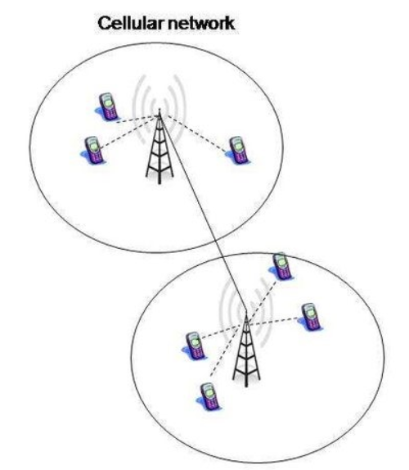
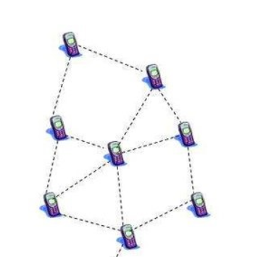
MANET vs TRADITIONAL NETWORKS
Traditional Networks :
Mobile terminals connect to base stations via wireless access networks.
Base stations are linked to wired backbone networks
Damage to base stations or infrastructure disrupts communication.
Traffic spikes and congestion hinder communication even without damage.
Repairing infrastructure costly and time-consuming.
MANET :
MANETs allow direct device-to-device communication without infrastructure.
They can be quickly set up in disaster areas for immediate communication.
MANETs adjust to changing conditions to maintain connectivity.
MANETs are a cost-effective solution compared to repairing infrastructure.
They aid in coordinating rescue efforts, minimizing loss of life and property.
MANETS

Slide 11
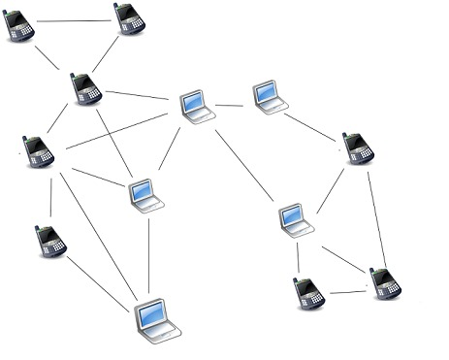
How does MANETs work ?
MANET nodes have capability to work as host as well as routers. each host has routing information of its connected neighbors.
When a node want to send a message, it broadcasts the destination address through its transmission network range.
If none of its neighbors matches to that destination address, all nodes in neighborhood broadcast that message until it reaches to the destination.

Slide 12

Direct Communication
Communication Mechanisms
Nodes dynamically discovers routes to other nodes in the network using Ad-Hoc On Demand Distance Vector (AODV) routing protocol
The communication between nodes can be done in two different ways :
Cluster based MANET
Cluster based MANET uses CBRP( Cluster Based Routing Protocol) and Dynamic Source Routing (DSR) protocol.
In our project we are using Direct Communication using AODV

Slide 13
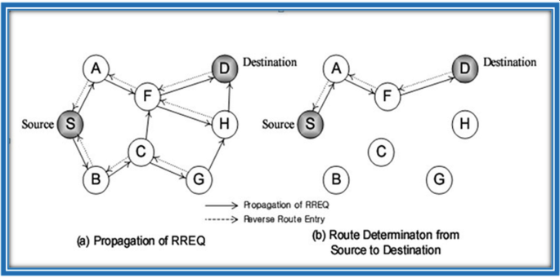
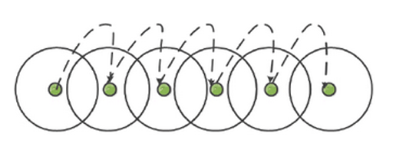
Direct Communication – AODV
AODV is one of routing protocol which helps nodes to communicate even if they are not directly connected i.e, not in close approximation.
They use Route Request (RREQ) messages from source node to destination.
RREQ message carry the following information:
• Source/destination address
• Unique message Id
• Lifespan
Direct Communication

Slide 14
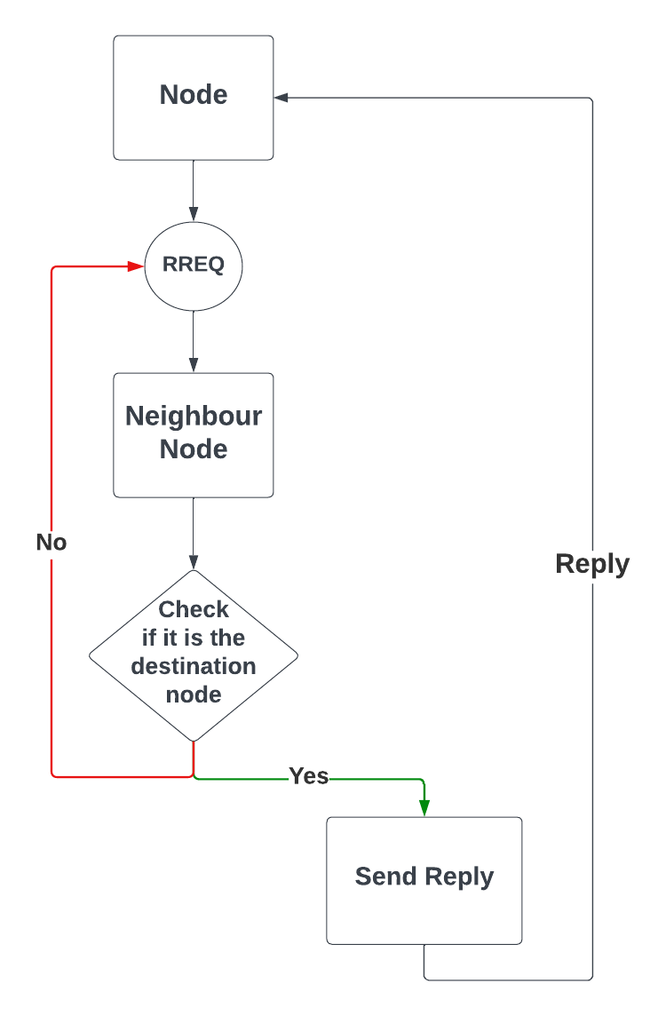
AODV - Functionality
When a Route Request (RREQ) is sent, neighboring nodes receive it and forward it if it's not addressed to them.
If the RREQ reaches its destination, a reply is sent back to the sender.
If the sender doesn't receive a reply within a timeout period, it retransmits the RREQ.
The timeout period is called lifespan and decreases until it reaches zero, triggering retransmission

Slide 15
RESULTS (VISUALIZATION)

Slide 16
CONCLUSION
In summary, Mobile Ad hoc Networks (MANETs) serve as crucial communication lifelines during disasters, bypassing traditional infrastructure limitations. Our project's implementation of the Ad hoc On-Demand Distance Vector (AODV) routing protocol demonstrates how such networks can efficiently connect devices, even in isolated areas. Through simulations in OMNeT++, we contribute to enhancing disaster response strategies, highlighting the significance of collaborative efforts in fostering resilience for a sustainable future.

Slide 17
FUTURE WORK
To address security threats in MANETs like eavesdropping and message tampering, we plan to implement RSA encryption. By integrating RSA, we'll strengthen data transmission, ensuring confidentiality and integrity. This effort will involve research to smoothly integrate RSA into the network while keeping performance efficient. Deploying RSA will proactively protect MANETs from potential attacks by malicious users.

Slide 18
Strategy 1
In the presentation session, the background can be filled with information that is arranged systematically and effectively concerning an interesting topic to be used as material for discussion at the opening of the presentation session.
Strategy 2
In the presentation session, the background can be filled with information that is arranged systematically and effectively concerning an interesting topic to be used as material for discussion at the opening of the presentation session.
Marketing Strategy
Strategy 3
Presentations are communication tools that can be used as lectures, speeches, reports, and more. It all depends on the purpose of your presentation.
In the presentation session, the background can be filled with information that is arranged systematically and effectively concerning an interesting topic to be used as material for discussion at the opening of the presentation session.

Slide 19
THANK YOU

